Slide 1
LF AI & Data Foundation
Executive Director

Slide 2
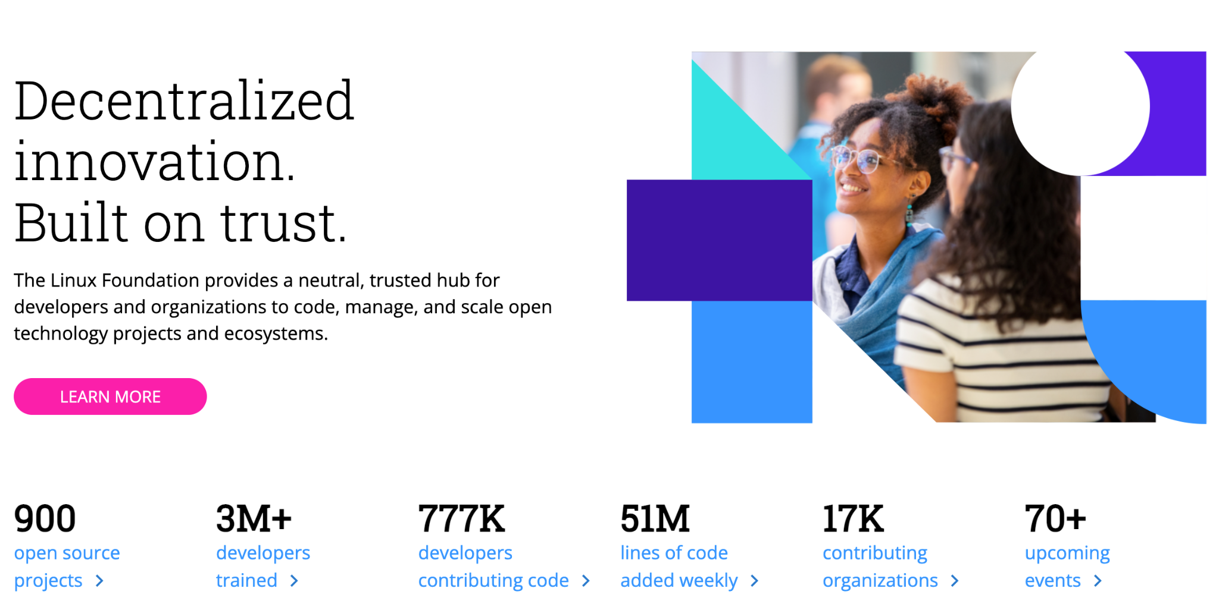

Slide 3
Some software is too important to be tied to a single host or controlled by a single company.

Slide 4
LF AI & Data is a neutral facilitator that brings experience and credibility to its projects and initiatives.
We host critical assets for AI & Data technology infrastructure and bring together the world’s top developers, organizations, end users, and vendors to identify and contribute to the projects and initiatives that address industry challenges for the benefit of all participants.

Slide 5
Why neutrality matters?
The biggest reason: Trust.
Trust that the decision makers are unbiased.
Trust that the project will stick around.
Trust that it is worth investing R&D budget.
Trust that the intentions of other participants are true.
Trust is an immensely valuable asset.
Required for participants to make durable strategic commitments.
Enables participants to form development alliances.
Encourages participants to contribute valuable features.
Trust in the host allows a project to thrive.

Slide 6
What does facilitator mean?
Successful Open Source foundations are facilitators, helping their projects thrive.
They do this by providing:
Non-profit status
Services tailored to the project such as IT, marketing, legal support, events, etc.
Knowledge and expertise, usually through experience staff .

Slide 7
Why experience and credibility matter?
A well-launched project will benefit from startup momentum for a long time.
However, this requires:
Help from people who have done it successfully before.
Knowledge of what works and what doesn’t.
Existing credibility with founding members.

Slide 8
Who is LF AI & Data?
The LF AI & Data is a global not for profit foundation that hosts critical components of the global AI & Data technology infrastructure. It brings together the world’s top developers, end users, and vendors to identify and contribute to the projects and initiatives that address industry challenges for the benefit of all participants.

Slide 9


Evolution & Mission
Our mission is to build and support an open AI community, and drive open source innovation in the AI, ML, DL and Data domains by enabling collaboration, sharing best practices, supporting development efforts, and the creation of new opportunities for all the members of the community.

Slide 10

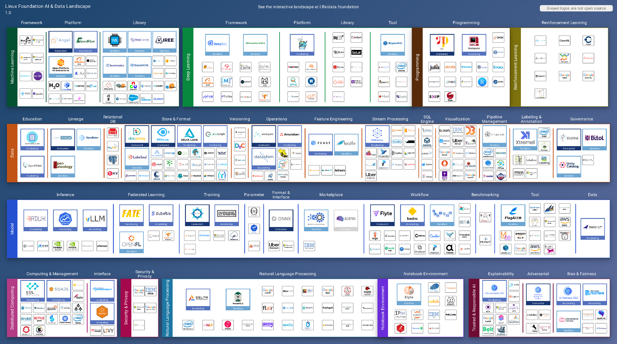

A growing ecosystem: The barrier to entry in AI is lower than ever before, thanks to open source software
365+ Projects
3.3M+ GitHub Stars
100K+ Developers
200+ Founding Org
600M+ LoC
1M+ LoC / Week
1000s of Contributing Orgs

Slide 11
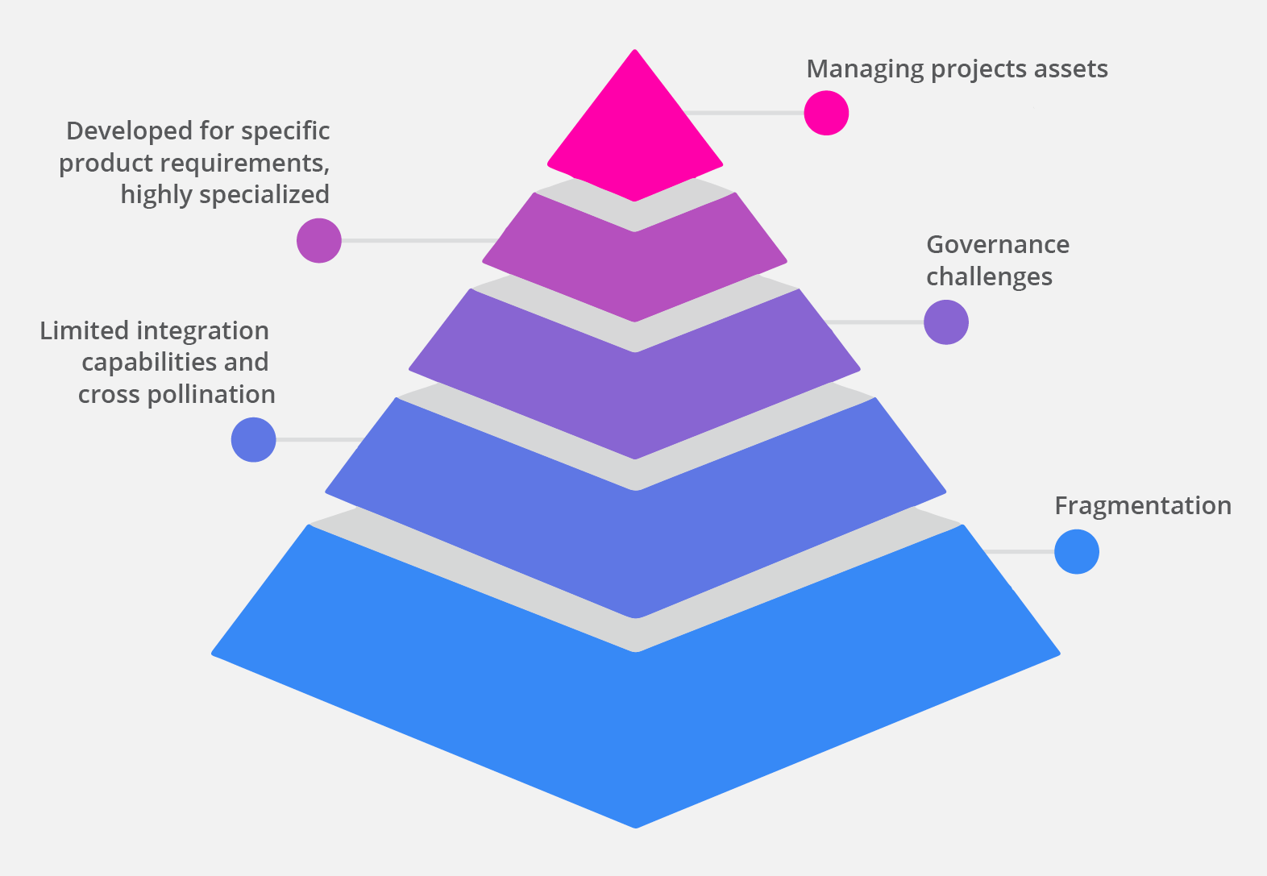
But with
challenges…

Slide 12
Open source libraries, frameworks, platforms, and tools are a two-way street: they make AI accessible to everyone, and companies benefit from the collective efforts of the community which helps accelerate open source AI applied R&D.
Transparency
Open Governance
Neutrality
Openness
Long term sustainability
Collective Testing
High Value
Lower Cost
Faster TTM
Better
Interoperability
Access to Talent
Ease of Integration
Notes:
Barrier to entry in AI has been lowered

Slide 13
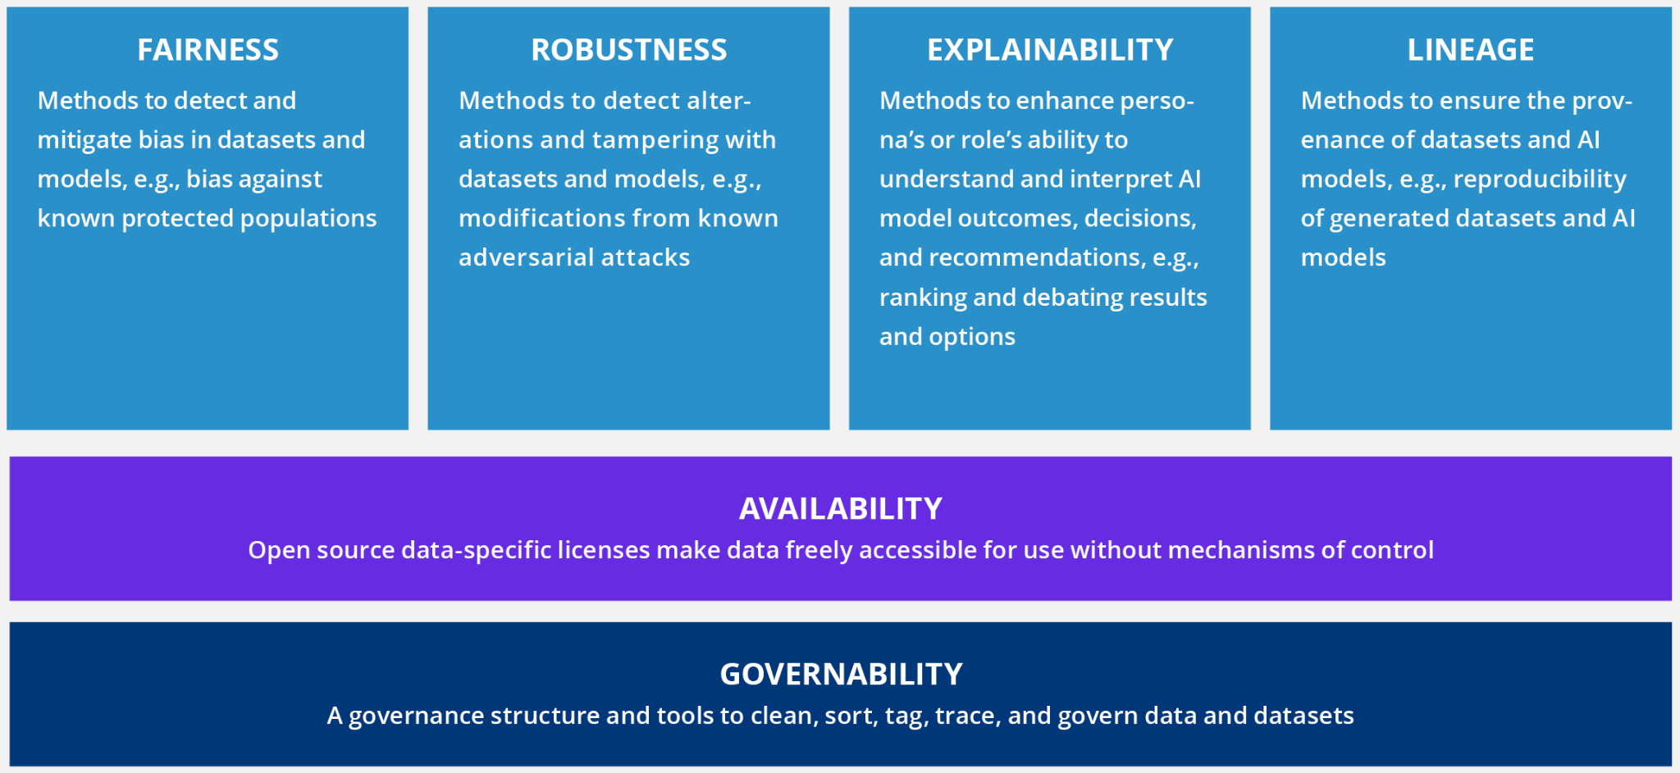
Open source benefits for AI & Data

Slide 14
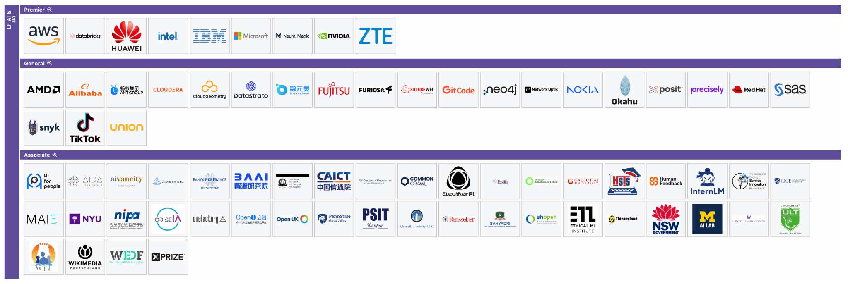
Members
Feb. 2024

Slide 15
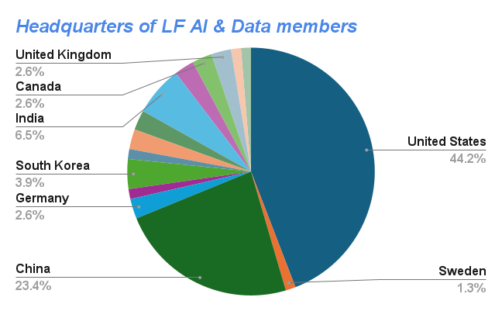

Slide 16
Committees / Workgroups
Technical Advisory Council (TAC)
Outreach
Committee
Generative AI Commons
DataOps
Marketing
Comms / PR
Events
Responsible AI
Education & Outreach
Models, Apps and Data
ML Ops
MLSecOps
APAC RUG
BI & AI
Japan RUG
‹#›

Slide 17
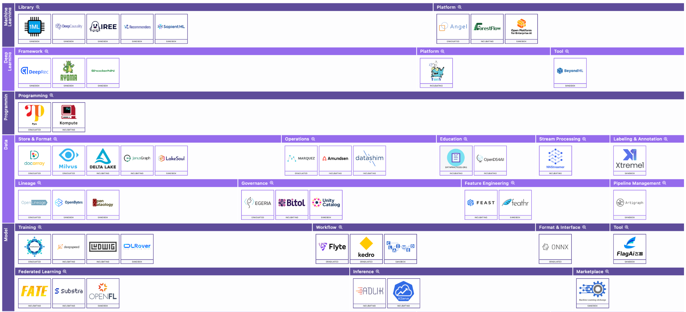
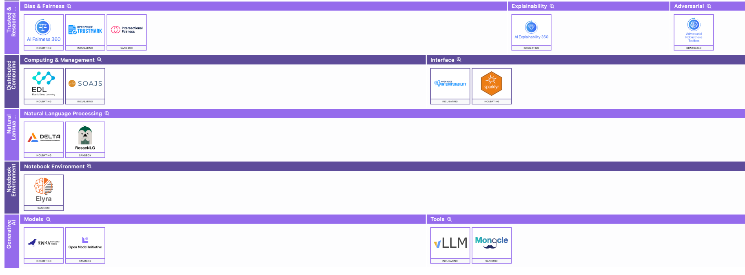
Projects Hosted in LF AI & Data

Slide 18
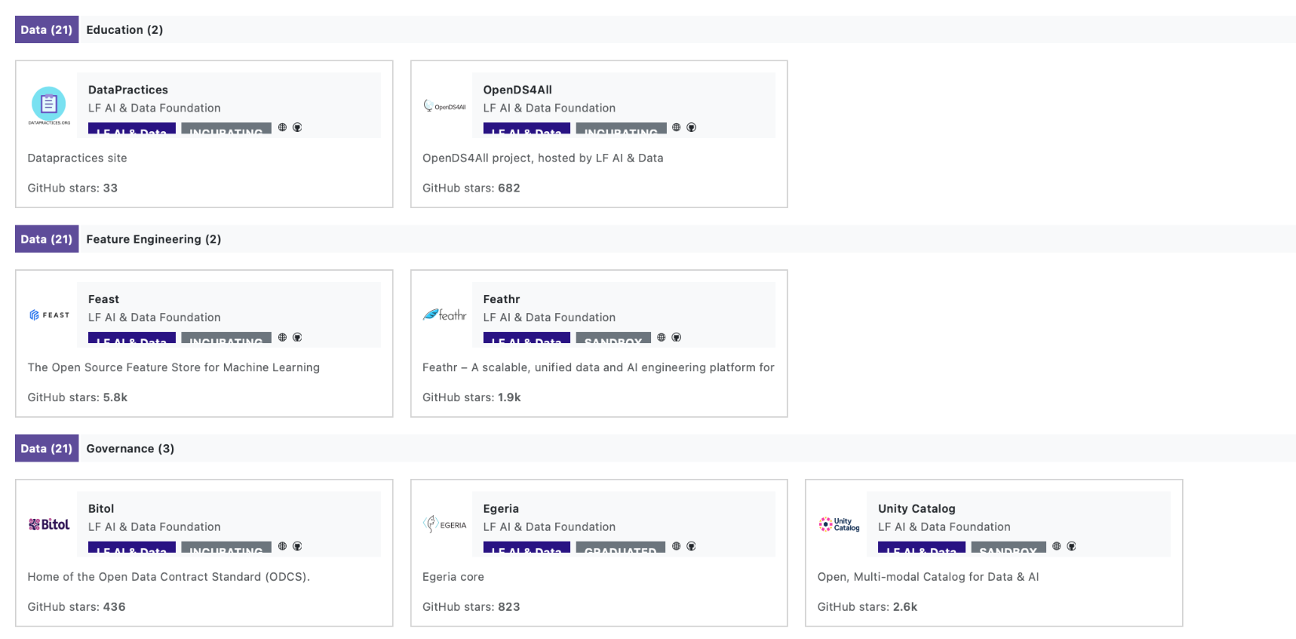
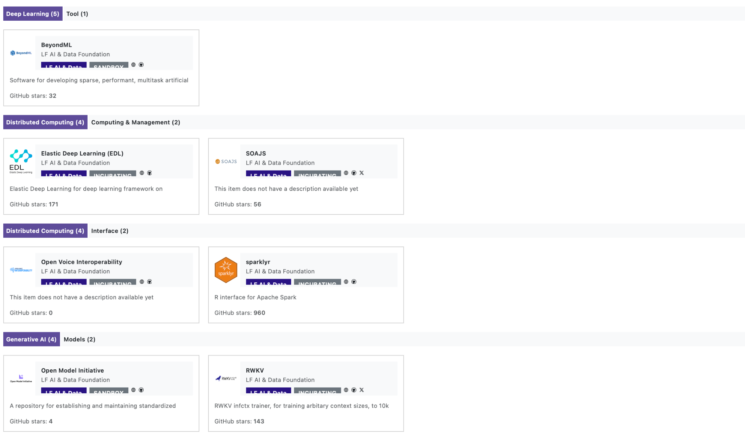
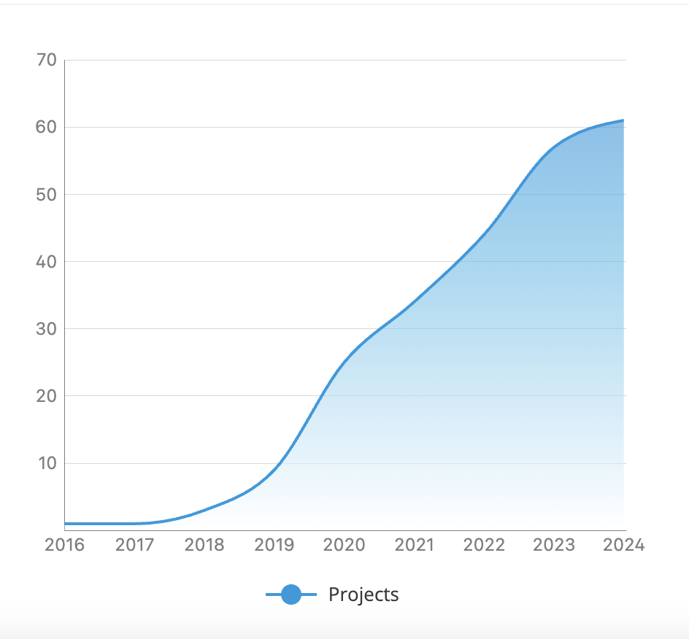
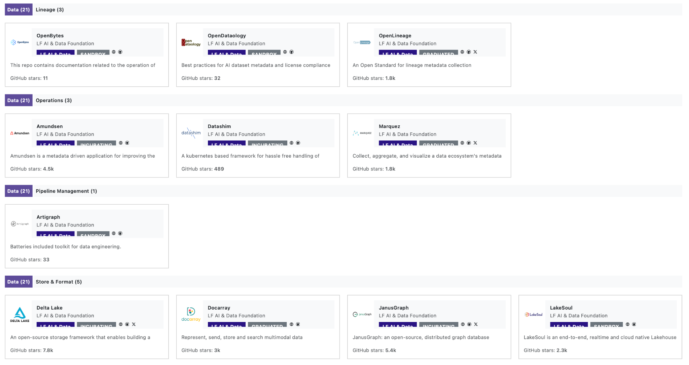
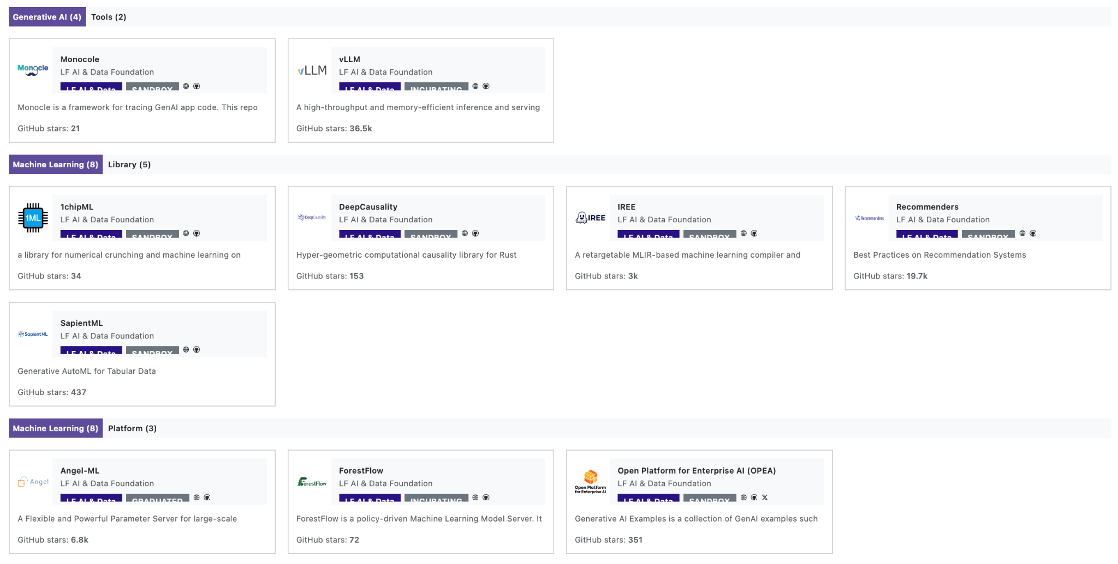
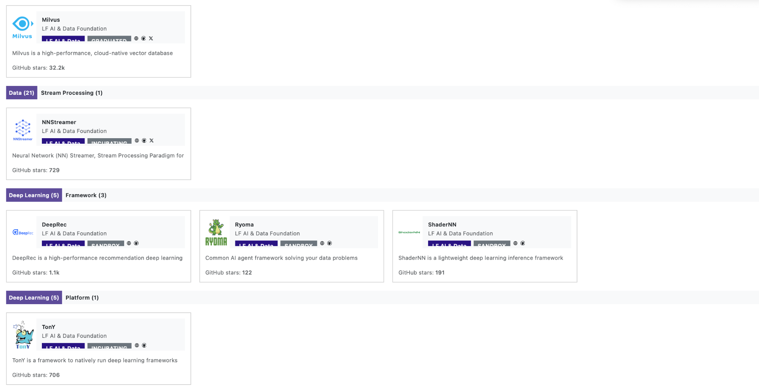
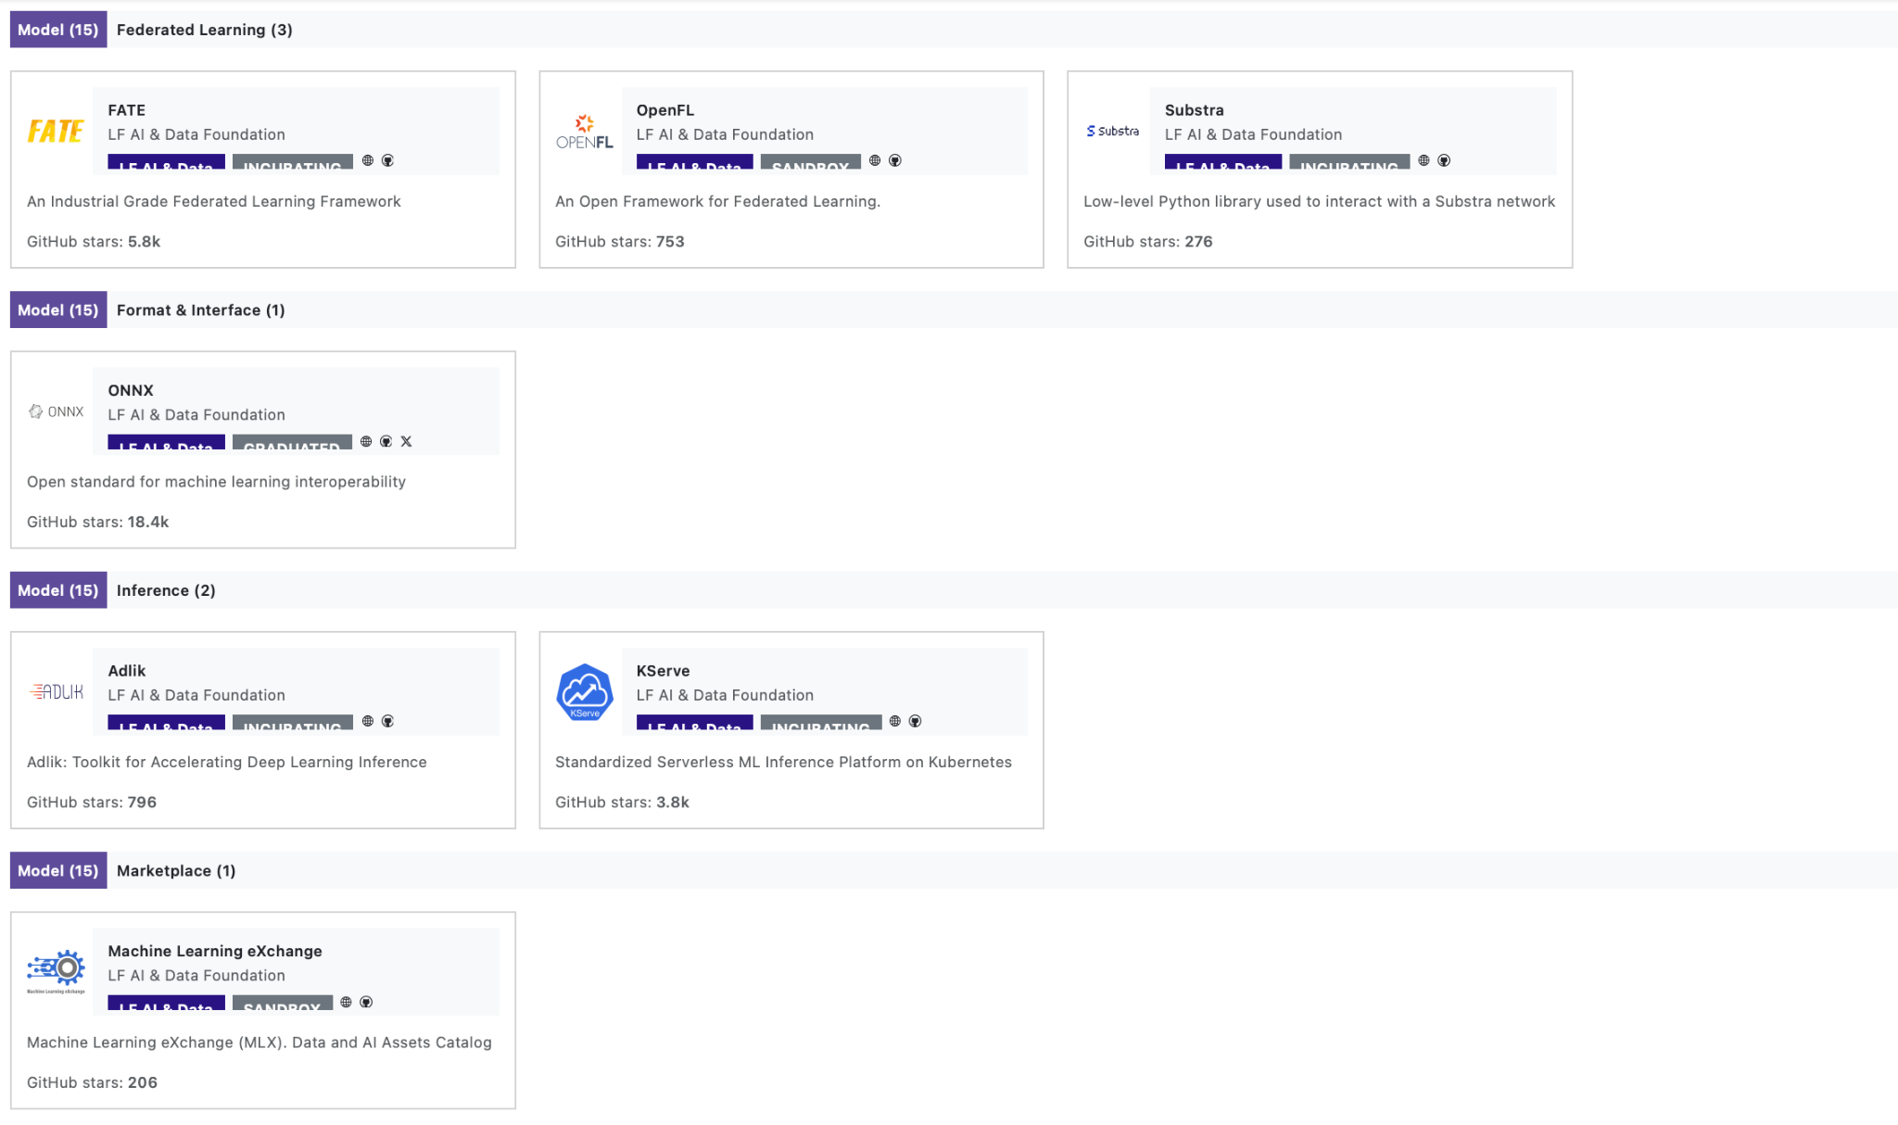
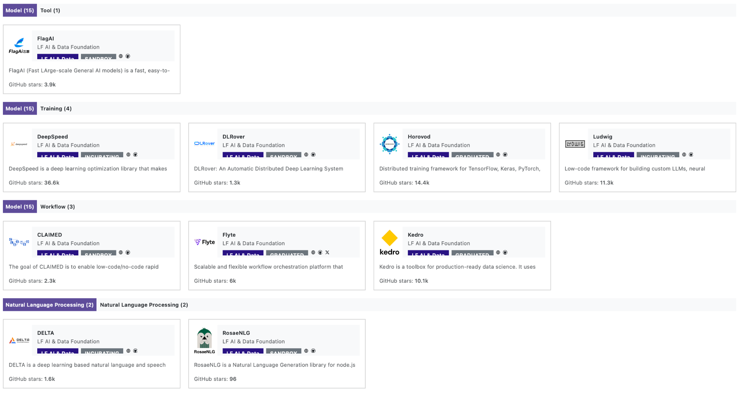
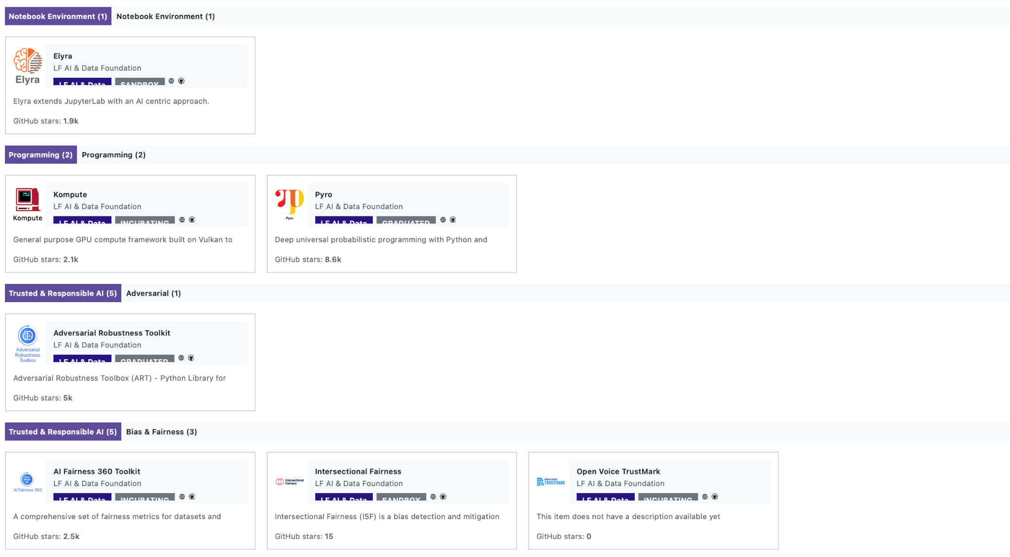
Growth of projects (2018-2024)

Slide 19
Hallmarks of a successful open source project
Thriving community: Projects should have (or be on track to building) an active, broad-based community.
Well-tested: Users should be confident that ecosystem projects will work well with the project, and include support for CI to ensure that testing is occurring on a continuous basis.
Clear utility / function: Users should understand where each project fits within the project’s ecosystem and the value it brings. Enables easy curation.
Permissive licensing: Users must be able to utilize ecosystem projects without licensing concerns (OSI-approved licenses)
Easy onboarding: Projects need to have support for binary installation options, clear documentation and a rich set of tutorials.
Ongoing maintenance: Project authors need to be committed to supporting and maintaining their projects.
Neutral hosting for project assets: All project’s assets are hosted and managed by a neutral party.

Slide 20
Why should you participate in open source AI development?
Alignment with upstream development for projects you depend on
Minimize technical debt and reduce development costs
Product enablement via project contributions (features, security, performance, etc.)
Influence technology direction via active participation in the projects
Access to talent, diverse and specialized
Enhanced interoperability and compatibility: OSS tends to adhere to standards, which can lead to better interoperability with other systems and reduce the risk of vendor lock-in.
Faster innovation and development cycles: Active participation in open source communities will enable you to tap into a global pool of talent and resources, accelerating the development cycle of its own software products
Boost your reputation, demonstrating a commitment to collaboration and innovation
Long-term sustainability of the projects you depend on
Engage with communities unlocks valuable partnerships and collaborations with other organizations, potentially opening new business opportunities

Slide 21
Open source and data
Data licenses
Data governance
Diverse data sets
Data tools
Open source data specific licenses such as CDLA make data freely accessible for use without mechanisms of control.
Open source offers a governance structure and tools to help govern data and data sets.
Open sourcing high-quality datasets allows others to reproduce and validate research, compare models, and develop new approaches. The availability of diverse and representative open source datasets is essential for training robust and unbiased models.
Open sourcing custom code or scripts for data preprocessing tasks is valuable to the community to understand used data preparation techniques and reproduce results.

Slide 22
2024 Key Stats
76
69
Members
Projects
236 M
356,000+
100,000+
2,920+
420M
420M
Contributing organizations
LoC
GitHub PRs
Contributors

Slide 23
Code Stats
May 19, 2023, Source: LFX Insights
Across 297 total repositories, an average of 35.64K LOC were added per repository on a weekly basis.
An average of 275.20M LOC were added in the last 5 years.

Slide 24
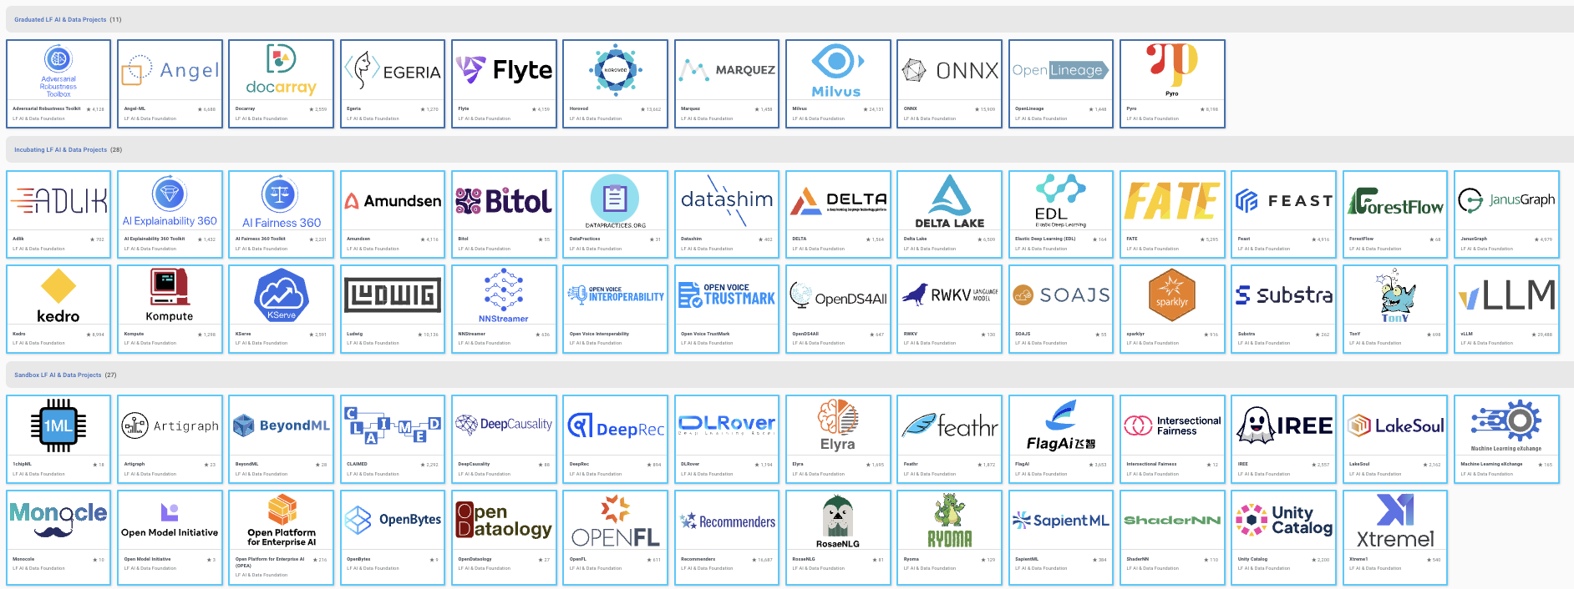
Growth of projects

Slide 25
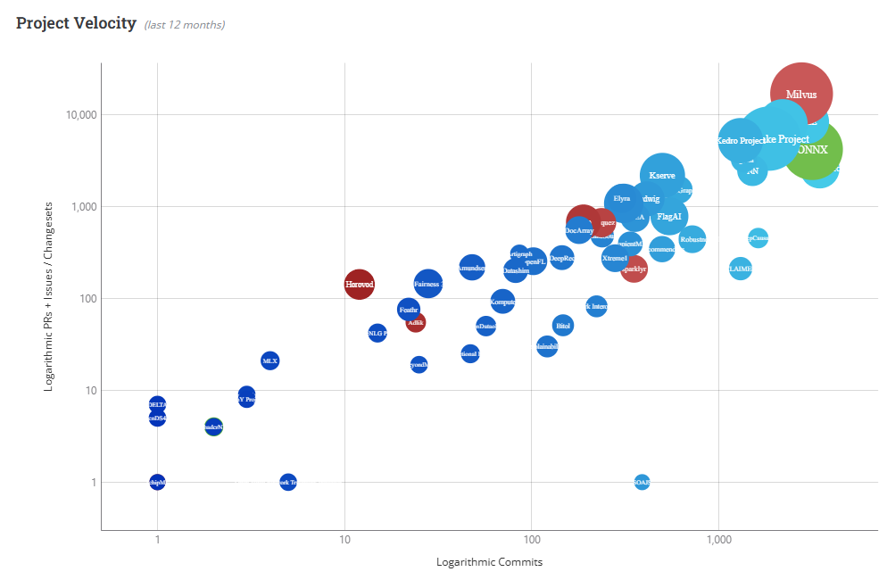

Projects Velocity

Slide 26
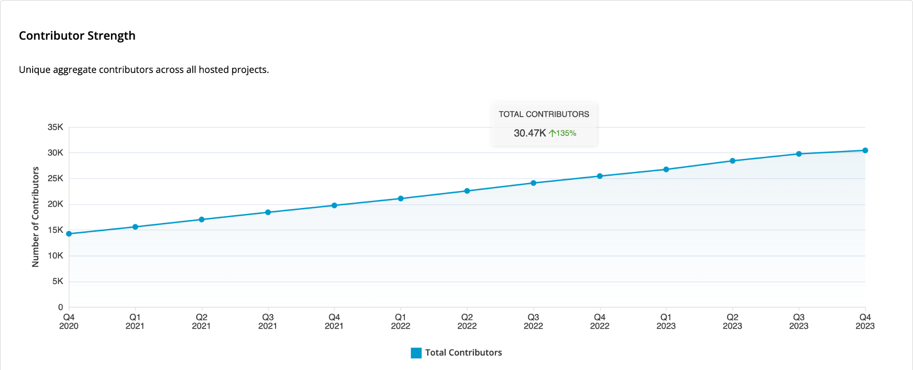
Total Number of Contributor

Slide 27

Our programs are enabling our projects to increase the contributions from existing developers and welcome new developers into projects at an unprecedented rate.

Slide 28
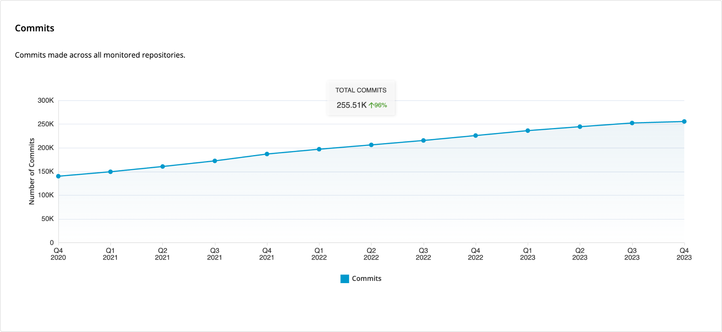
Commit Growth

Slide 29
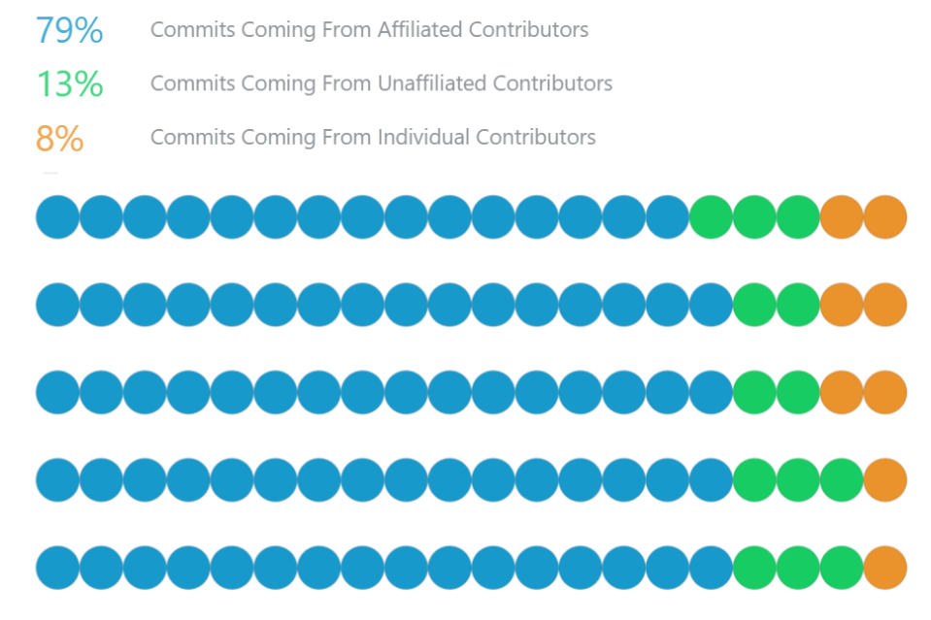
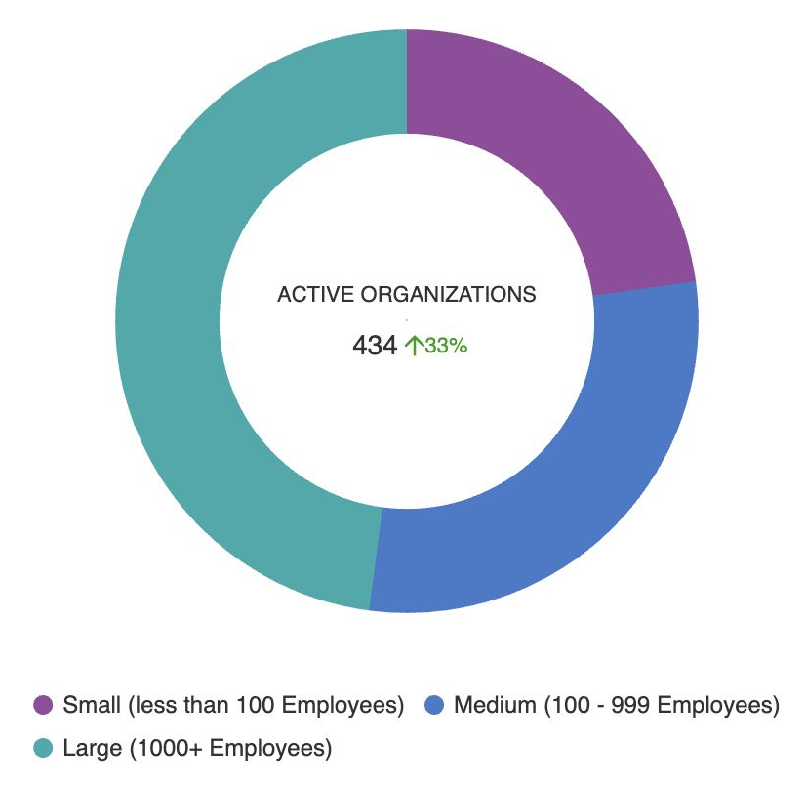
Organization Engagement
A total of 658 organizations participated in the code commits during the past 5 years.
434 organizations participated in the code commits in 2023

Slide 30
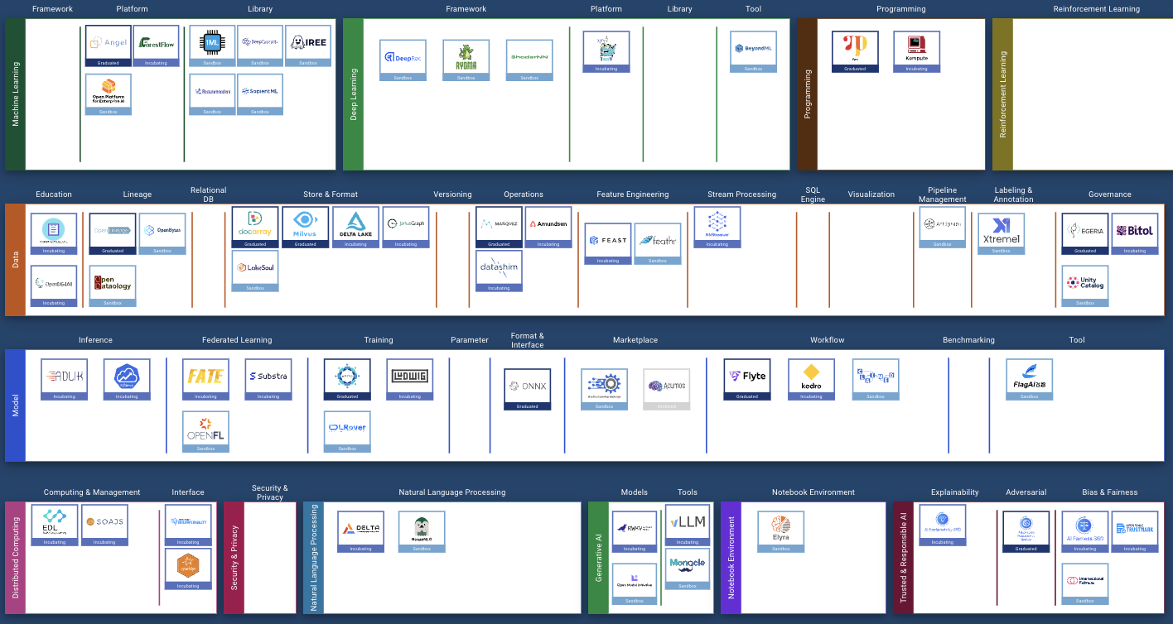
15% of Key Ecosystem Projects Depend on LF AI & Data

Slide 31
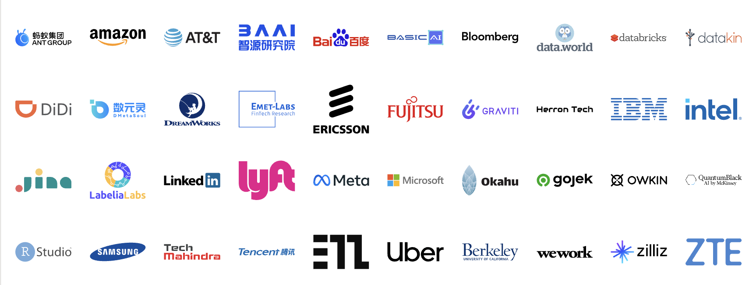
Industry Leaders Host Projects in LF AI & Data

Slide 32
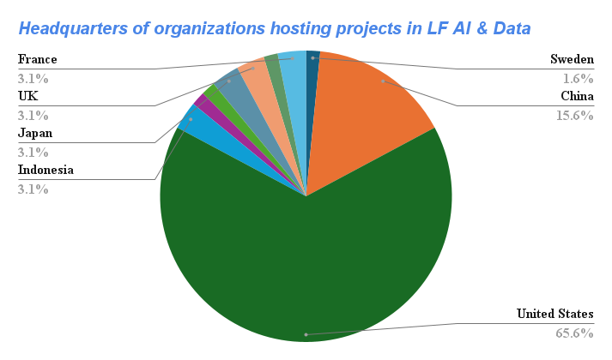

Slide 33
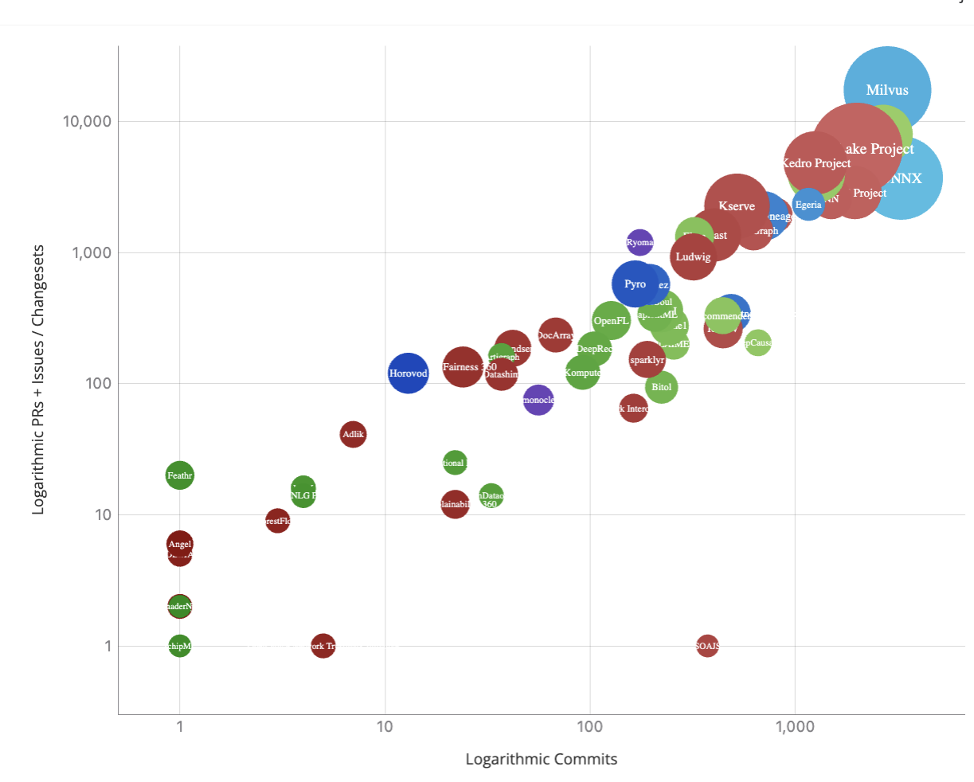
Project Velocity
LF AI & Data supports projects in accelerating their progress, growing their developer community, and driving adoption.

Slide 34
With 67+ Hosted Technical Projects, LF AI & Data offers all required open source software and elements required to build and manage an end-to-end ML Workflow
Open Source Data
Data prep
Data Governance
Data cleansing
Data ingestion
Data analysis & transformation
Data validation
Feature Engineering
Data splitting
Model creation
Trust Management
Open Source Marketplace
Building
an open source model
Training
Optimization
(incl. compute optimal)
Model validation
Training
at scale
Open Source Model
Rollout
Open Source Data
Security Management
Deploying
Serving
Monitoring & Logging +
Explainability
Fine tune & improvements
Cloud
Edge
Open Source Model
‹#›

Slide 35

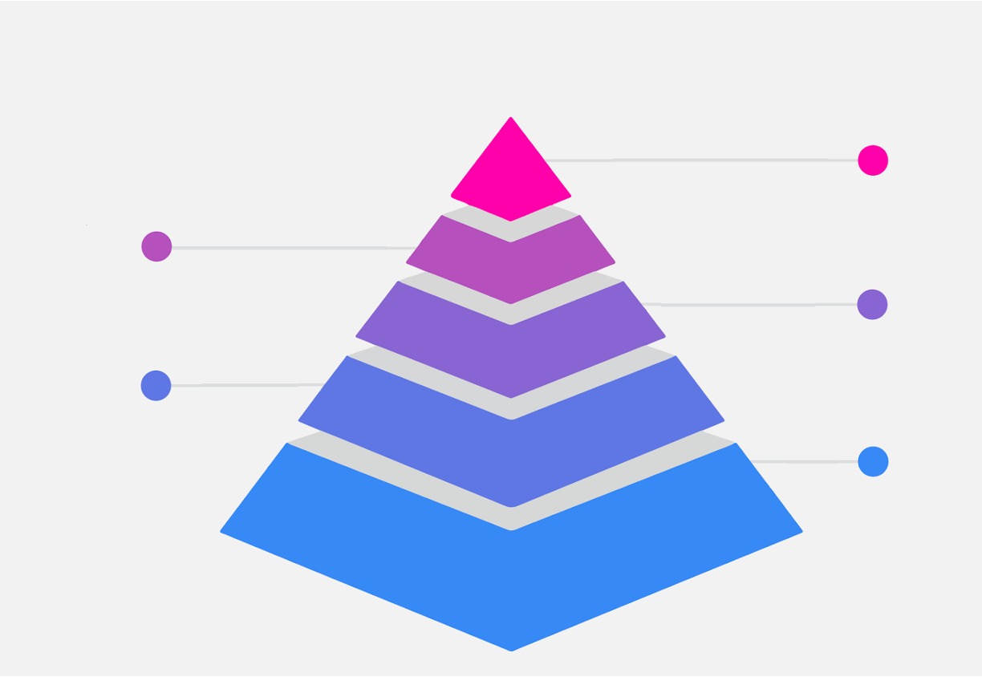
LF AI & Data is addressing key ecosystem challenges
Providing a safe haven and managing technical and non technical project assets
Supporting functional growth of hosted projects
Not-for-profit host & technical open governance
Fostering technical integration and collaboration across projects
Minimizing fragmentation, rallying industries around a set of leading projects

Slide 36
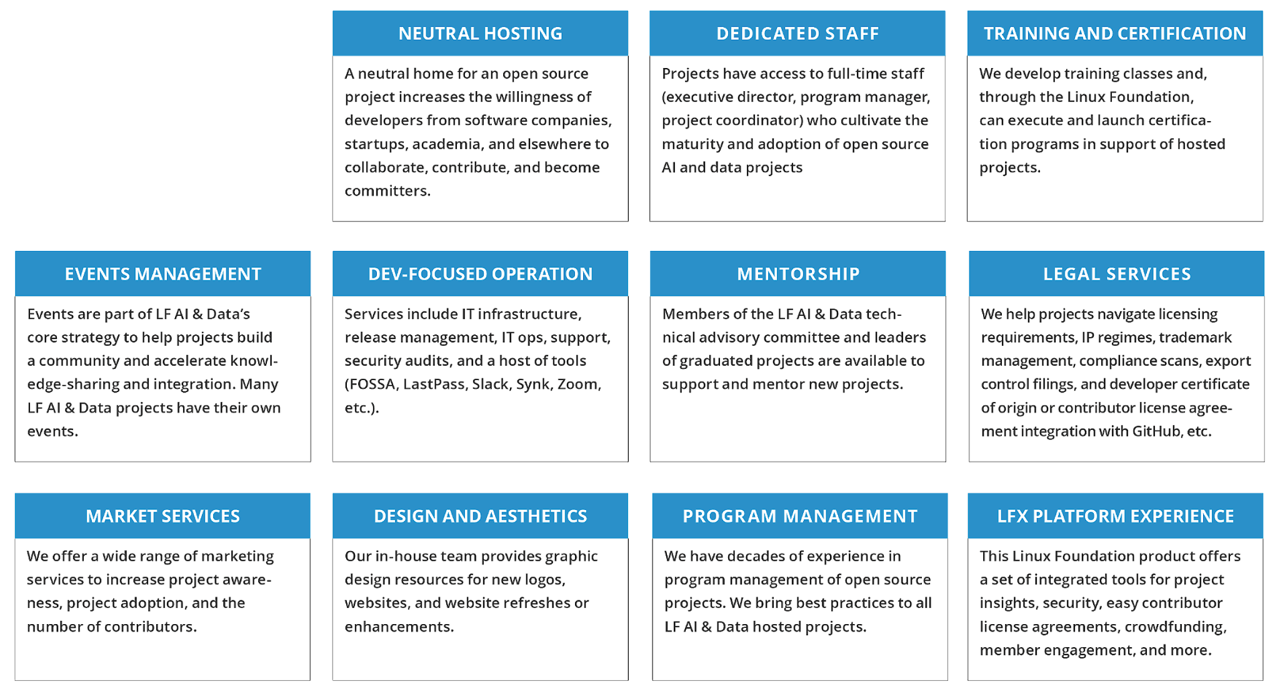
Support Programs Available to Hosted Projects

Slide 37





















Strong Project Participation from China
Hosted Projects
Organizations Hosting
Projects

Slide 38


Focused Developer & Community Marketing Effort
MarComm services to support community and ecosystem engagement
Events and community ecosystem building services
Events and promotion
Project
graduation
OSS Summits
KubeCon
AICON
+
GOTC
Project
incubation
AI.Dev
LF AI &
Data Days
Kubernetes
& AI
Project
releases
Project cross
collaboration

Slide 39
Open AI Challenges
No consistent definition of “open” in AI
Open source software licenses used on non-software elements
Modified licenses, inclusion of AUPs (Acceptable Use Policies)
Lack of understanding of license implications
Many model components are not released
Open-washing
Keeping track - Rapidly growing # of available models

Slide 40
Why Launch Generative AI Commons in the LF?
Not-for-profit
A non-profit that hosts and promotes the collaborative development of open source projects (sw, hw, standards)
Neutral
Trusted neutral foundation hosting projects and their IP, increasing the willingness of organizations to collaborate & contribute
Credible
3000+ members, 1000+ open source projects, launching cross industry efforts, leading oss technologies in all industry sectors
Open Governance
Open, transparent and fair governance model across all efforts and projects in the Linux Foundation and its umbrella foundations

Slide 41
Available Support Programs
Growth
Build momentum within the LF community of thousands members
Financial Support
Raise and manage funds for the projects or launched efforts
Experience
A team of professional dedicated staff who share deep open source experience
Asset Manager
Manage project/community assets with deep expertise at large scale
Ecosystem Builder
Building ecosystems across oss, open hw, standards, and data sharing
Credible Entity
In launching cross industry efforts, leading oss technologies in all sectors
Resources
Events, PM support, community, LFX Platform, marketing, training & cert, IT, Creative, market services
Legal Services
Trademark management, license compliance, export control filings, DCOs, CLAs, etc.

Slide 42
Generative AI Commons - Initial Workstreams
Emerging LLM Architectures
Curation of oss projects
Security
Privacy
Trusted & responsible AI
Model-Centric
Hosting models
Collaborating on building foundational models
Hosting Gen AI tools
Application framework tools
Data-Centric
Hosting and curating open source datasets
Hosting Data supporting tools (db, annotation, labeling, workflow, etc.)
Education & Outreach
Share knowledge and expertise
Provide thought leadership
Training and certification
Share best practices
Openness Framework
A framework to evaluate the openness of ML models by measure of how many of its elements are made available under an open source license.

Slide 43
Challenges Open AI
The challenges in AI model licensing encompass issues such as ambiguous definitions of "openness," diverse restrictions across licenses including Acceptable Use Policies (AUPs), incomplete release of components like datasets, and misuse of open source licenses on non-software elements, all contributing to legal uncertainties and barriers in adoption.

Slide 44
Challenges in Open AI
Lack of a common understanding of openness in AI
Open source software licenses used on non-software assets
Diverse restrictions including the use of Acceptable Use Policies
Lack of understanding of license implications
Incomplete release of model components

Slide 45
Challenges in Open AI
No consistent definition of “open” in AI
OSS licenses used on non-software assets
Modified licenses, inclusion of AUPs (Acceptable Use Policies)
Lack of understanding of license implications
Many model components are not released
Open-washing
Keeping track - Rapidly growing # of available models

Slide 46


Evaluating Models based on their completeness and openness following open science principles
https://genaicommons.org/
The Model Openness Framework (MOF) offers guidance to researchers and developers seeking to enhance model transparency and reproducibility while allowing permissive usage.
MOF removes ambiguity and provides transparency and clarity surrounding availability of components, licensing, and suitability for commercial use without restrictions.
Notes:
Aspire model creators to release more model elements under unmodified open source licenses.

Slide 47

















MOF Components
CODE
Evaluation Code
Preprocessing Code
Model Architecture
Libraries & Tools
Inference Code
Training Code
DATA
Datasets
Evaluation Data
Sample Model Outputs
Model Weights & Parameters
Model Metadata
Configuration File
DOCUMENTATION
Data Card
Research Paper
Evaluation Results
Model Card
Technical Report
‹#›

Slide 48
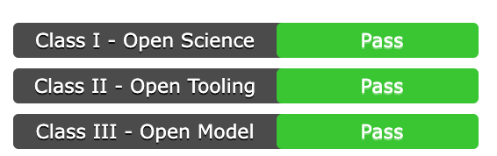
MOF Class | Components Included
Class I – Open Science | Research Paper Datasets Data Preprocessing Code Model Parameters and Metadata (Intermediate Checkpoints and Optimizer States) + All Class II Components
Class II – Open Tooling | Training Code Inference Code Evaluation Code Evaluation Data Supporting Libraries & Tools + All Class III Components
Class III – Open Model | Model Architecture Model Parameters and Metadata (Final Checkpoints and Optimizer State) Technical Report Evaluation Results Model Card Data Card Sample Model Outputs (optional)

Slide 49
MOF Benefits
Benefits to model producers
Build a vibrant ecosystem around your models
Spur innovation and improve upon your work
Improve your models and datasets through feedback
Appease regulators through greater transparency and reproducibility
Improve safety and security of models
Benefits to consumers
Access to more model components
Clarity on what models can be used for what purposes
Build products on top of open models
Enhance models for one’s own purposes
Collaboration with a broader community
Accessibility for research, education & innovation

Slide 50
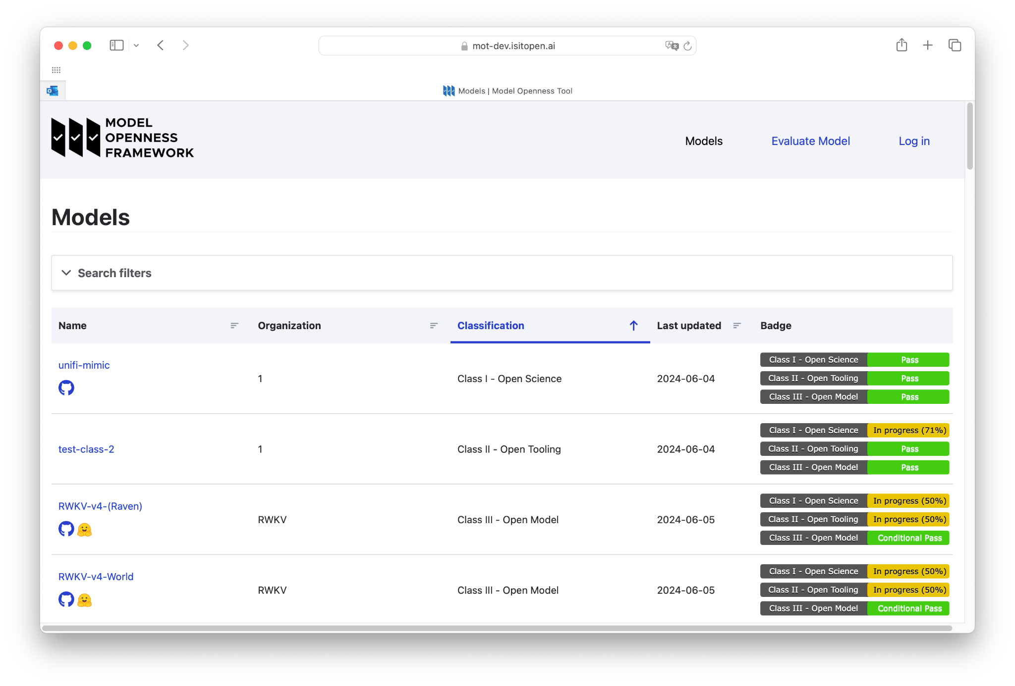
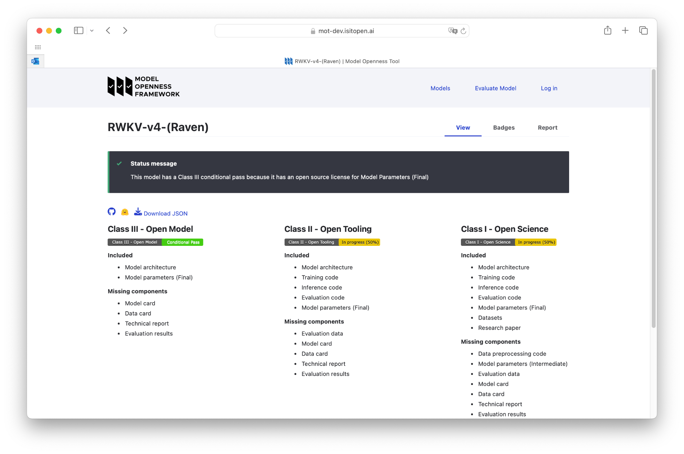
Model Openness Tool - beta release https://isitopen.ai/

Slide 51
Don’t believe calls to “pause” or “restrict” open source AI
It didn’t work with cryptography it won’t work here
Security through obscurity doesn’t work
Regulatory capture of open source is anti-innovation and anti-competitive
The market is already addressing AI concerns this with responsible AI market solutions

Slide 52
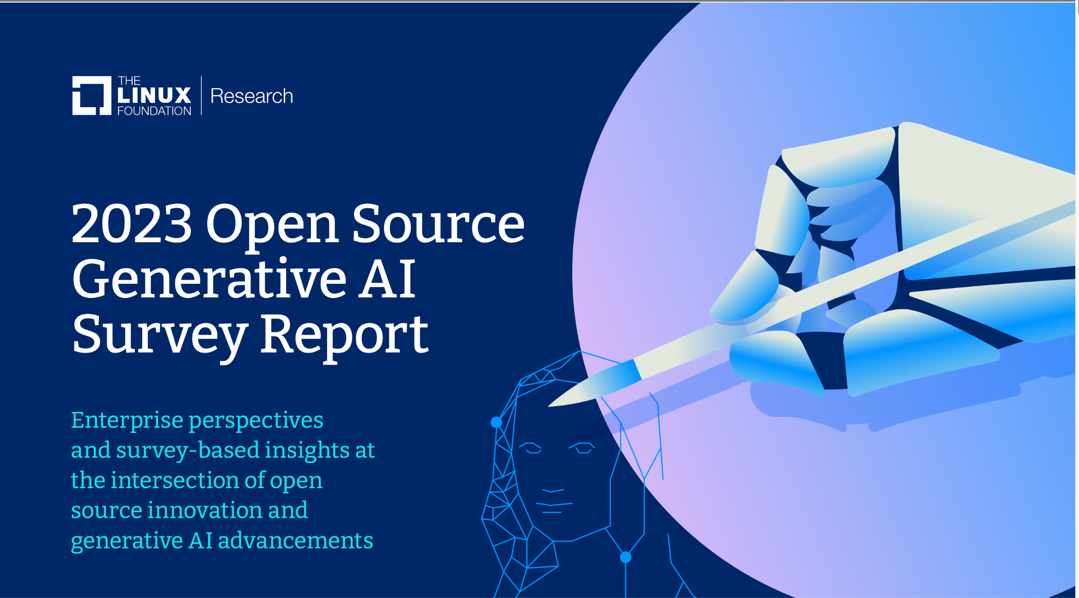
Gen AI Survey Report - December 2023 - Overview
The State of Generative AI and Open Source Innovation in Enterprises
A global survey conducted by LF AI & Data in collaboration with LF Research
Delves into GenAI’s integration into businesses and its openness.
Explores findings highlighting sustainable and ethical development.
Focuses on AI systems like large language models (LLMs) and usage of open-source databases, applications and frameworks in enterprise and industry.
Read Report
Download report, images and infographics.

Slide 53
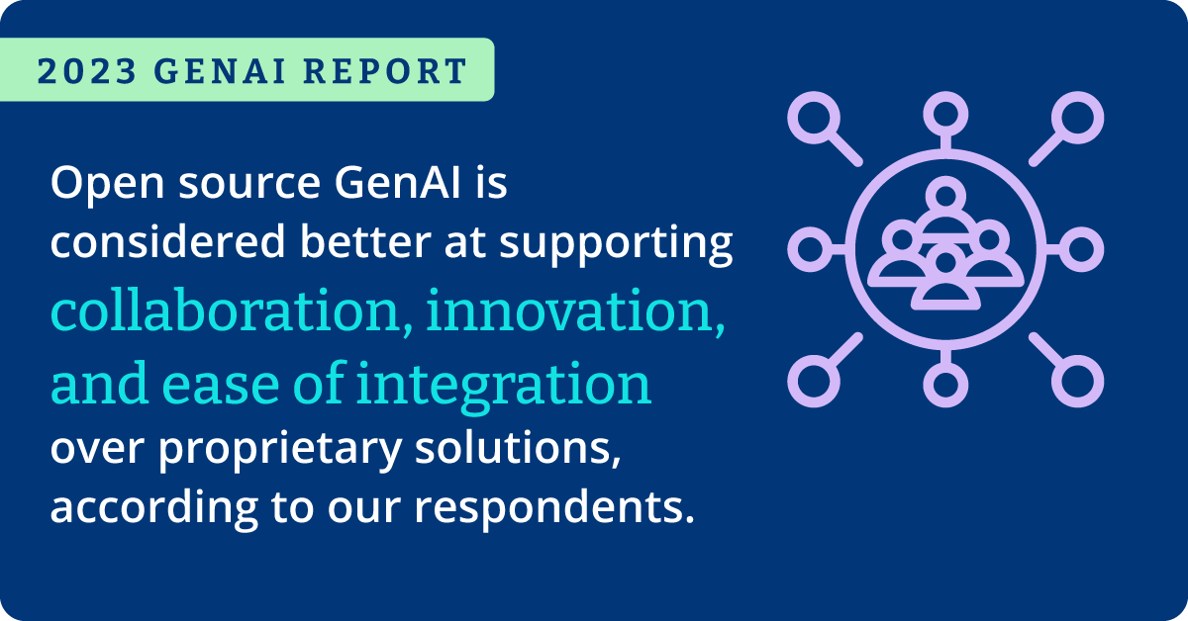
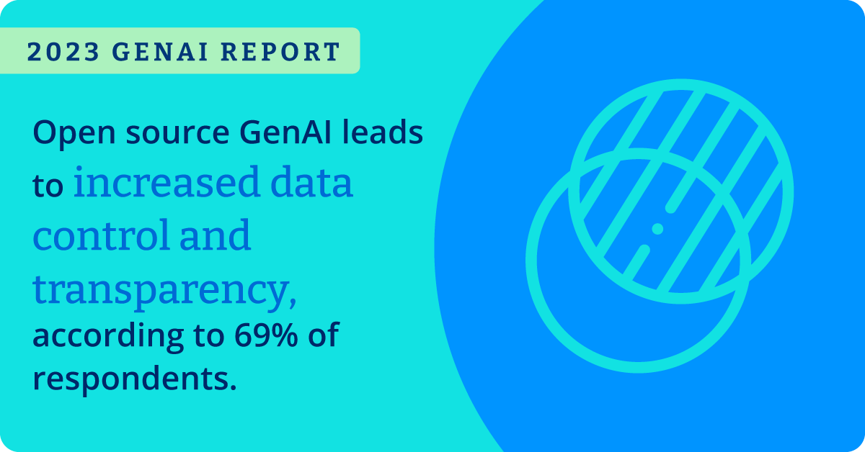

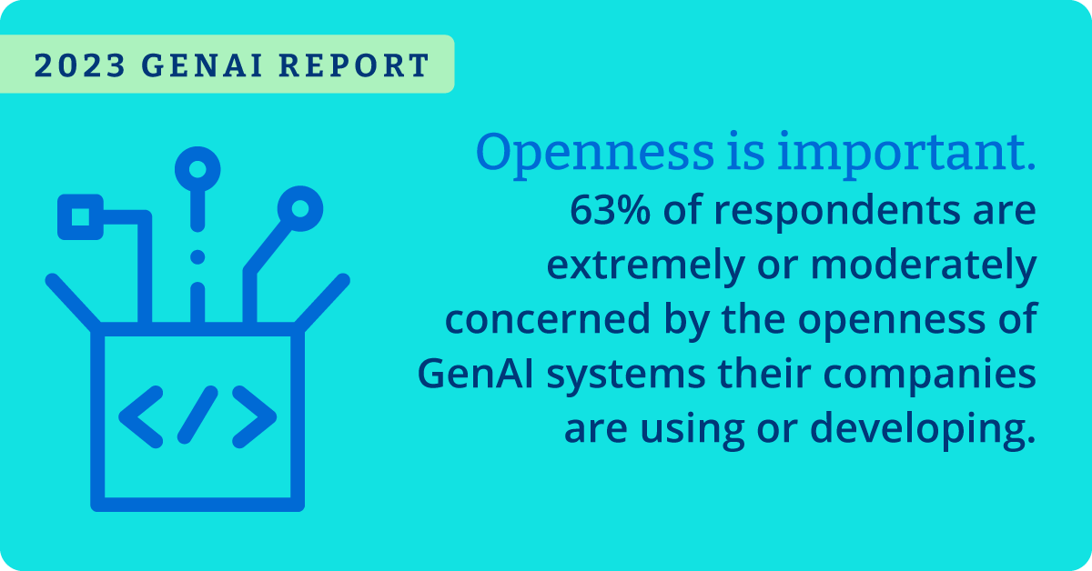

Slide 54
A Year in Review
+11
+22
+7500
Gen AI Commons
420M
420M
420M
420M
AI.Dev
Projects
Members
New Contributors
40+ companies
100+ participants
Dec 12-13 San Jose, CA, USA

Slide 55









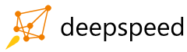

New Projects in 2024

Slide 56











New Members in 2024
Premier (Board)
General

Slide 57
Pre-AI “Open Source” package
Software License
Software
Documentation

Slide 58
Pre-AI “Open Source” had ancillary components that enabled the system to work, some open, some not
Applications
Software License
Systems Administration Tools
Dependencies
Database
Software
Documentation
Third Party Libraries
Operating System
OS Libraries

Slide 59
AI-Era “Open Source” is complicated as AI itself is more complicated, not just code and documentation
Code - Data - Documentation
Model
Model Parameters
Evaluation Results
Model Card
Data
Training Code
Libraries and Tools
Data Card
Data Preprocessing Code
Inference Code
Model Metadata
Research Paper
Training, Validation and Test Code
Evaluation Code
Sample Model Outputs
Technical Report
Notes:
From Matt: @mdolan@linuxfoundation.org as a talking point I would highlight that the power in today's deep learning models like LLMs is in the data and data is not just the raw and processed datasets but the model weights.
Also without datasets there cannot be full transparency, reproducibility and innovation is limited. If we look at the 4 freedoms of open source software and apply them to AI models and their artifacts, we need all of the artifacts to achieve the same level we have with just source code and documentation with conventional software.

Slide 60
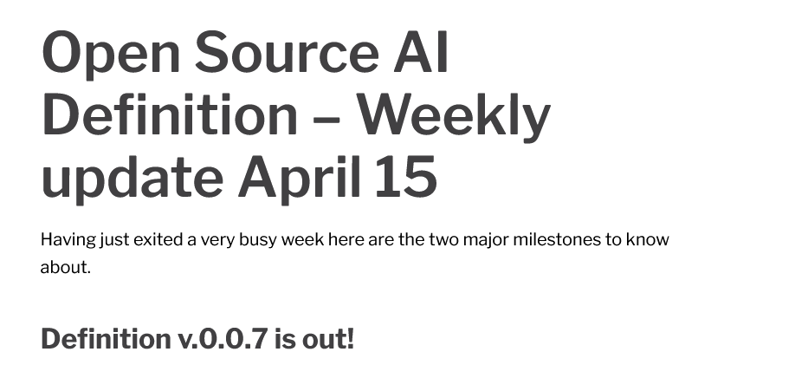

OSI is working to define open source AI, but industry will likely need more than just a definition of open
https://opensource.org/blog/open-source-ai-definition-weekly-update-april-15

Slide 61
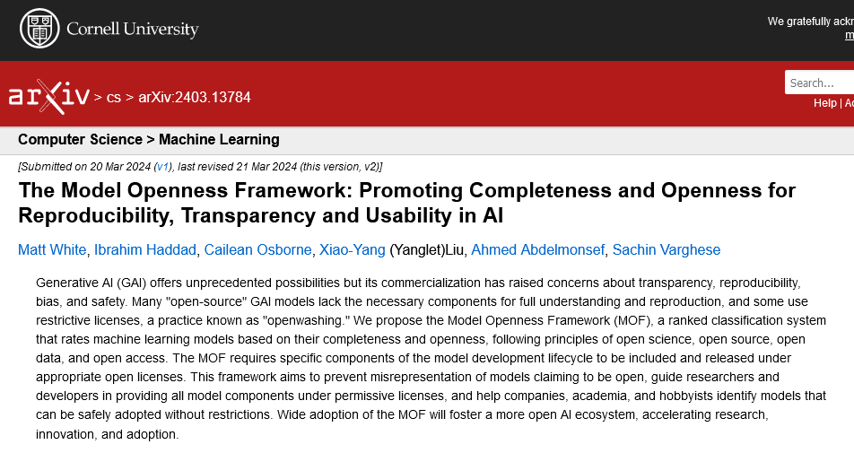


The LF AI & Data community is working on the Model Openness Framework
Moving the community to release more model components for completeness and using the appropriate open licenses for openness
Get Involved and join the Generative AI Commons open community: genaicommons.org
https://arxiv.org/abs/2403.13784

Slide 62



The Importance of Standardized Definitions in AI Models
Need for Clarity and Avoiding Confusion
Standardized definitions ensure consistent understanding across the open source AI community. Without common terms, stakeholders might mis-align expectations.
Enabling Collaboration
Clear definitions foster a productive, cohesive ecosystem, promoting sustainable, transparent AI innovation.
Informing Regulation
Accepted industry definitions are easier to understand and map to any regulatory constructs

Slide 63


What Are Open Source AI Models?
Open source AI models provide the model architecture, weights, and information about the data used to train the model, licensed for unrestricted use, modification, and distribution.
Built on open source software, enabling developers and researchers to reuse and innovate without restrictions.
Accelerates AI advancements by encouraging collaboration across industries and reducing redundancies.

Slide 64


What Are Open Science AI Models?
Open science AI models build on open source AI models by offering full transparency — source code, training data, and research for reproducibility.
Focuses on transparency and reproducibility, ensuring the entire process can be understood and replicated.
Fosters trust, accountability, and scientific rigor, advancing AI research with more robust and trustworthy systems.

Slide 65
MOF Class | Compatible with Definition | Components Included
Class I: Open Science | Open Science AI Model | Research Paper Datasets Data Preprocessing Code Model Parameters and Metadata + All Class II Components
Class II: Open Tooling | Open Source AI Model | Training Code Inference Code Evaluation Code Evaluation Data Supporting Libraries & Tools + All Class III Components
Class III: Open Model | Open Source AI Model | Model Architecture Model Parameters and Metadata Technical Report Evaluation Results Model Card Data Card Sample Model Outputs (optional)

Slide 66
Aligning with OSI and Moving Forward Together
These definitions are not competing with OSI’s efforts to define “Open Source AI.” They are a narrower focus, building on the Model Openness Framework from LF AI & Data.
OSI & LF AI & Data efforts aim to promote openness, transparency, and collaboration in the AI ecosystem, ensuring alignment with the broader open source community.
To participate in shaping these definitions and contributing to the open source AI ecosystem, join the discussions within LF AI & Data and the broader community.
Your feedback is invaluable! → https://genaicommons.org/

Slide 67
Standardizing Language for Legislation and Legal Codification
Support for Policymakers: By adopting standardized definitions we provide clear, consistent terminology that can be referenced by legislators and regulators. This standardization helps avoid ambiguities when creating policies around AI technology.
Facilitating Legal Frameworks: Consistent definitions make it easier for policymakers to codify rules and regulations related to AI development and deployment, ensuring alignment with open source principles and the values of transparency, accountability, and reproducibility.
Enabling Global Alignment: As AI governance becomes a priority for governments worldwide, these standardized definitions can serve as a foundation for aligning international legal frameworks around the use and distribution of AI models, promoting responsible AI innovation globally.

Slide 68
Hosting Process

Slide 69
Technical Advisory Committee
The TAC serves a coordination role:
Votes on new projects joining LF AI & Data, as well as on promoting projects across incubation stages
Facilitates communication and fosters collaboration across hosted technical projects
Communicates needs and requirements of the projects to the Governing Board
Onboards new projects, assists in progression of existing projects, and reviews projects annually
Defines and maintains the technical vision for the LF AI & Data Foundation
Creates a conceptual architecture for the projects, aligning projects, promoting, removing or archiving projects
Defines common practices to be implemented across LF AI & Data projects
Meetings via conference calls take place every 2 weeks, are recorded and open to the general public
https://wiki.lfai.foundation/pages/viewpage.action?pageId=7733341

Slide 70
Project Incubation levels
Sandbox
Any project that intends to join LF AI & Data Incubation in the future and wishes to lay the foundations for that.
New projects that are designed to extend one or more LF AI & Data projects with functionality or interoperability libraries.
Independent projects that fit the LF AI & Data mission and provide the potential for a novel approach to existing functional areas (or are an attempt to meet an unfulfilled need).
Incubation
Sandbox requirements plus:
Have 2+ organizations actively contributing to the project.
Have a defined Technical Steering Committee (TSC) with a chairperson identified, with open and transparent communication.
Have a sponsor who is an existing LF AI & Data member.
Have at least 300 stars on GitHub.
Have achieved and maintained a Core Infrastructure Initiative ​Best Practices Silver Badge​.
Have the affirmative vote of the TAC.
Graduated
Sandbox and Incubation requirements plus:
Have a healthy number of code contributions coming from at least five organizations.
Have reached a minimum of 1000 stars on GH.
Have achieved and maintained a Core Infrastructure Initiative ​Best Practices Gold Badge​.
Have demonstrated a substantial ongoing flow of commits and merged contributions for the past 12 months.
Receive the affirmative vote of two-thirds of the TAC and the affirmative vote of the Governing Board.
Have completed at least one collaboration with another LF AI & Data hosted project
Have a technical lead appointed for representation of the project on the LF AI & Data TAC

Slide 71
Incubation Requirements
Sandbox
Fit the scope and mission of LF AI & Data
Have an OSI-approved license.
Have a sponsor who is an existing LF AI & Data member. Alternatively, a new organization would join LF AI & Data and sponsor the project’s incubation application.
Have an open and documented technical governance. The LF team can help set this up.
The project's founders adopt an open governance model documented in a Technical Charter for the project, and execute the Project Contribution Agreement transferring the project’s assets to the LF.
Incubation
Have at least three organizations actively contributing to the project.
Have a defined Technical Steering Committee (TSC) with a chairperson identified, with open and transparent communication.
Have reached a minimum of 500 stars on GitHub.
Have achieved and maintained an OpenSSF Best Practices Badge Program (Silver).
Graduate
Have a healthy number of code contributions from at least five organizations.
Have reached a minimum of 1000 stars on GitHub.
Have achieved and maintained an OpenSSF Best Practices Badge Program (Gold).
Have demonstrated a substantial ongoing flow of commits and merged contributions for the past 12 months*.
Have completed at least one collaboration with another LF AI & Data hosted project

Slide 72
Transitioning from Incubation to Graduation
The TAC will undertake an annual review of all projects
Projects in the Sandbox Stage are generally expected to move to Incubation within 12 months from joining the Foundation following an evaluation by the TAC committee
Projects in the Incubation Stage are generally expected to move to Graduation within 12-18 months from joining the Foundation following an evaluation by the TAC committee
Projects can be provided with an extension of time in their stage (up to the discretion of the TAC)

Slide 73
Project Lifecycle
TAC Sponsor
TAC Majority vote
TAC Sponsor
TAC Majority vote
TAC 2/3 vote
GB Majority vote
TAC Majority
vote
Sandbox
Incubation
Graduate
TAC 2/3 vote
GB 2/3 vote
TAC 2/3 vote
GB 2/3 vote
Any project may be moved to Archived status, provided that the transition has secured:
TAC affirmative ⅔ vote
GB affirmative ⅔ vote
Archived

Slide 74
Process for proposing a project for hosting in LF AI & Data
Decide on a date to present to the TAC and request incubation
Ensure that your project implements these recommendations
Submit a formal request to incubate the project via a GH PR
Prepare deck and share with ED about 10 days prior to the presentation
Present to the TAC and get approval
Onboard the project with the LF AI & Data team and integrate the project with our service
Announce the project becoming hosted in LF AI & Data

Slide 75
Incubation Benefits by Levels
Sandbox
Neutral hosting of the project’s trademark and assets by LF AI & Data.
Appointment of a TAC member as a project sponsor
LF AI & Data blog post or similar announcing the project's hosting in the Foundation
Right to refer to the project as an “LF AI & Data Sandbox Project,” and to display the LF AI & Data logo on the project’s code repository and web properties
An initial and regularly scheduled license scan of the project’s codebase
Ongoing source code security scans and reports
Infrastructure support includes mailing lists, wiki space, slack channel, etc.
Marketing, communication, and PR support are limited to significant announcements.
Access to the LFX platform.
Support of the Foundation staff who are eager to help with the project.
Incubation
Sandbox benefits plus:
Right to refer to the project as an “LF AI & Data Incubation Project,” and to display the LF AI & Data logo on the project’s code repository.
Creative and artwork support covering website, logo, and other required creative work.
Marketing, communication, and PR support, including project promotion via blog posts, social media, and LF AI & Data website.
Access to the Bevy platform for community-hosted events.
Graduate
Incubation benefits plus:
LF AI & Data blog announcement or similar announcing the project graduation, including promotion activities.
Graduation stage projects may receive support as determined by the Governing Board.
Right to refer to the project as an “LF AI & Data Graduation Project,” and to display the LF AI & Data logo on the project’s code repository.
Voting seat on the TAC.
Advanced IT infrastructure support (pending board approval).
Additional ecosystem development opportunities include training courses, certification development, and conformance programs (pending board approval).

Slide 76
LF AI & Data Membership Benefits
LF AI & Data is positioned to bolster cross-company collaboration and interoperability with our neutral IP zone, rich contributor programs, and most importantly, the trust end users place in us.

Slide 77
Organizations join LF AI & Data to take an active role in supporting the growth and evolution of the Open Source AI & Data ecosystem
Support our mission, programs, and the community by helping fund services that hosted projects rely on
Demonstrate thought leadership by participating in a wide reaching networking and marketing programs
Be part of defining and maintaining technologies that are at the forefront of the industry
Host projects with us and benefit from the services & support we offer our hosted projects to increase their adoption and footprint in the ecosystem
Provide technical leadership to the community via the TAC, its various sub-committees and efforts
Receive greater insight into the foundation’s strategy, efforts, projects and initiatives through increased engagement with the ED, staff and committees’ leads

Slide 78


LF AI & Data Membership Benefits
Marketing Amplification & Brand Awareness
Community Engagement
Thought & Tech Leadership Across Key Technologies

Slide 79





Marketing amplification and brand awareness
Broaden your reach and awareness in the community with LF AI & Data marketing programs.
As a member you can participate in:
LF AI & Data Outreach Committee
Participate in the marketing committee monthly to engage with your peers in the cloud native space.
LF AI & Data Online Programs
Showcase your organization’s open source technology by educating new and existing community members about best practices, trends, and new technologies.
LF AI & Data Blog
Showcase your thought-leadership and industry commentary, as well as share technical walkthroughs for LF AI & Data projects here.
LF AI & Data Summit
LF AI & Data organizes its own community’s open source developer summits focused on open source AI and Data technologies.
Public Relations & Analyst Relations Support
LF AI & Data supports members with analyst reports and research highlights.

Slide 80





Community Engagement
LF AI & Data is a constellation of open source projects. Our members leverage many efforts to engage with our project’s ecosystems and share their stories. As a member you can participate in:
ML Workflow and Interoperability
Design a reference architecture for end-to-end ML Workflow, provide a reference implementation using hosted projects, and facilitate integration and interop across projects.
Trusted AI
A global group working on policies, guidelines, tools and use cases by industry to ensure the development of trustworthy AI systems and processes to develop them continue to improve over time.
DataOps
Share best practices, and bring technology awareness around DataOps across industries and enable collaboration across LF AI & Data member companies, projects, and external participants.
BI & AI
Integrate the power of AI and BI to make it CI (Cognitive Intelligence) by combing the speed machines accelerate (AI) with the direction intuited by human insight (BI).
LF AI & Data Day
A 1-day event organized multiple times per year focused on specific technical projects and collaboration ongoing in LF AI & Data.

Slide 81


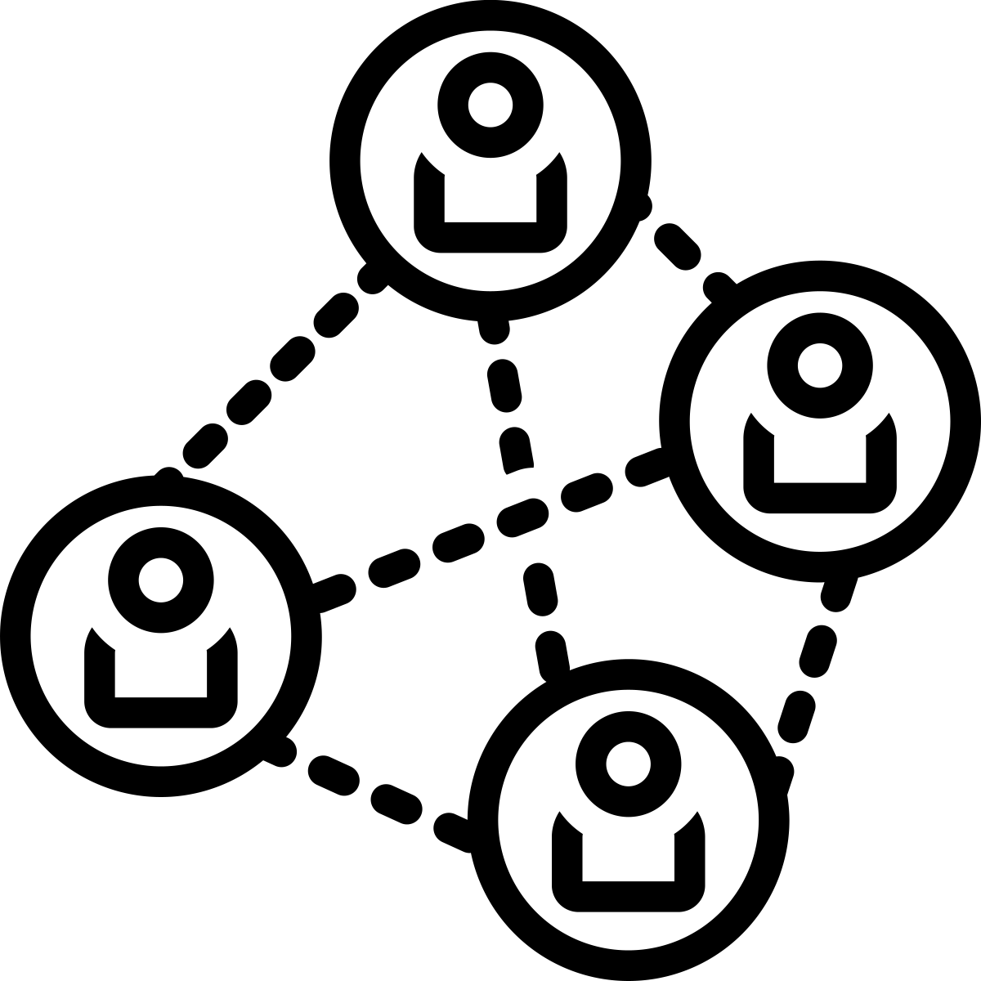

Thought leadership
Members of the LF AI & Data can network and help shape the open source AI and Data market.
As a member you can participate in:
Governing Board Participation
Participate in elections to serve on the Governing Board to oversee the vision of LF AI & Data and work with the TAC.
Engagement with other Foundations and Industry Consortia
Participate in establishing collaborations with other umbrella foundations under the LF and broadly with other industry consortia organizations.
Technical Advisory Council Leadership
LF AI & Data TAC provides technical leadership to the open source AI and Data community, accepts projects into incubation, graduates projects and launches new efforts and collaborations.
Interactive Landscape Placement
Our landscape is a comprehensive view of all open source AI and Data critical projects in the ecosystem. Anyone looking to adopt open source AI and Data projects comes here to review what technologies they should assess and adopt.

Slide 82
LF AI & Data Annual Dues
Not Yet a Linux Foundation Member
Existing Linux Foundation Member
Premier Member
$170,000
$150,000
General Member
5,000 employees +: $60,000
2,000 - 4,999: $40,000
500 - 1,999: $30,000
100-499: $20,000
Up to 99 employees: $15,000
5,000 employees +: $40,000
2,000 - 4,999: $25,000
500 - 1,999: $15,000
Up to 499 employees: $10,000
Associate Member
Free
Limited to academic and nonprofit institutions respectively and requires approval by the Governing Board

Slide 83

Premier Membership
Highest tier of membership – for organizations contributing heavily to open source AI and Data, and bringing their own projects to be hosted at the Foundation. They work in concert with the Foundation team members. These companies want to take the most active role in enabling the open source AI and Data ecosystem.
Premier members are eligible to:
(Enjoy all the benefits of General level, plus;)
Hold one (1) guaranteed seat on the LF AI & Data Governing Board + one alternate (1) representative
Appoint one (1) voting representative in any subcommittees or activities of the LF AI & Data Governing Board
Receive greater insight into LF AI & Data strategy and projects through engagement with the LF AI & Data leadership team. Premier level members have the unique opportunity to customize their experience with LF AI & Data. The team will make themselves available to help achieve your strategic goals. We can help with guidance in open source contributions, new market creation, and/or open source project donation. Have ideas? Just ask!
Enjoy most prominent placement in displays of membership including website, landscape and marketing materials.
Create an individualized press release upon membership announcement with the LF AI PR team.

Slide 84

General Membership
Targeted for organizations that want to support of LF AI & Data and our mission. Organizations that join at the General level are deeply committed to using open source technology, helping LF AI & Data grow, voicing the opinions of their customers, and giving back to the community.
General members are eligible to:
Participate in elections between other General members to appoint one (1) representative to the LF AI & Data Governing Board. Three (3) total General representatives will be elected to represent all General members. Voice your opinions amongst the leaders in the industry and help determine the strategic direction of LF AI & Data.
Receive greater insight into LF AI & Data strategy and project roadmaps through increased engagement with the LF AI & Data Executive Director and staff.
Create an announcement upon membership announcement with the LF AI & Data PR team.
Participate in all Marketing, Community, Thought Leadership opportunities.
Opportunity to host “LF AI & Data Day”, including on-demand webinars and livestream.
Receive discounts on LF AI & Data event sponsorships.
Demonstrate your support for LF AI & Data by displaying your logo on the LF AI & Data website, landscape and in marketing materials.

Slide 85

Associate Membership
The Associate membership is a free complimentary membership limited to academic and non-profit institutions.
Associate members are eligible to:
Participate in all Marketing, Community, and Thought Leadership opportunities.
Identify your organization as a member and display your logo on the LF AI & Data website, landscape and in marketing materials.
Feature your organization in the quarterly new members announcement.
Receive discounts on LF AI & Data events’ sponsorship.

Slide 86
Ways to improve members retention
Improve the product - deliver more value
Improve the onboarding process - connect more users to the existing value
Make it stickier - make the value hard to give up
Catch them before they leave - give them an excuse to stay
Remind them of the value - deliver value more often
Bring them back after they’ve gone - remind them of what they’re missing
Change them - target a more suitable audience

Slide 87
Challenges and Trends

Slide 88








Global Open Source Trends
Training & Cert,
Talent Shortage
Emphasis on SW Supply Chain
Rise of Adoption of OSPOs
Importance of Software Security
Infusing AI and ML in products and services
Focused Efforts on Ethical AI Practices
Criticality of OSS to Digital Transformation
Accelerated OSS Adoption in Governments

Slide 89
Emerging AI Trends
Emergence of Small and Medium Language Models | Smaller, more efficient models. Striking a balance between performance and resource requirements, making them suitable for various applications, especially in resource-constrained environments.
Customized Local Models and Efficient Data Pipelines | Shifting toward customized AI models tailored to specific use cases. Organizations are creating local models that cater to their unique requirements, leveraging domain-specific data and fine-tuning.
AI on Edge, On-Device LLM Models | Increased adoption of Edge AI due to its benefits on privacy by processing data locally, latency reduction and real time decision making.
AI Ethics and Transparency | Increased focus on developing AI systems that are fair, unbiased, and ethically sound, addressing issues of accountability and trust. Organizations and governments are developing guidelines and regulations to ensure transparency, fairness, accountability, and privacy in AI systems.
Fast-Paced Legislative Process | Governments are rapidly adapting to regulate AI. Legislation covers areas like data privacy, bias mitigation, and AI accountability, impacting how organizations develop and deploy AI solutions.
Open Source, AI & Collaboration | The open-source community was, is and will continue to play a crucial role in shaping AI development.

Slide 90








AI Challenges and Opportunities
Trusted and Responsible AI
AI on edge
devices
Federated learning
Social Impact
Specialized Hardware
Availability of Skilled Talent
Scalability, Efficiency
Policies, Regulations & Standards
User Acceptance, Building Trust

Slide 91




Data Challenges and Opportunities
Security
Quality
Lineage
Deriving value
Integration
Ethical
Licensing
Labeling
Diversity
Governance
Privacy
Accessibility
Regulations
Storage
Bias
Standards
Quantity
Legislations
Compliance

Slide 92
LLM Trends
Model Size
LLMs have been steadily increasing in size and complexity. The shift from GPT-2 to GPT-3 saw a 100x increase in model parameters, and 6x increase from GPT-3 to GPT-4, enabling more nuanced language processing and higher-quality outputs.
Pre-training and Fine-Tuning
Pre-training on large-scale datasets followed by fine-tuning on specific tasks has become a common approach in LLM development. This two-step process enhances model performance and allows for transfer learning across domains.
Few-shot and Zero-shot Learning
LLMs have shown promising capabilities in few-shot and zero-shot learning, where they can perform tasks with minimal or no task-specific training examples. This trend has implications for rapid prototyping and reducing data requirements.
Multimodal LLMs
There is an increasing focus on developing multimodal LLMs that can process and generate text in conjunction with other media types, such as images, audio and video. These models enable more comprehensive and interactive AI experiences.

Slide 93
LLM Challenges
Ethical Concerns
LLMs raise ethical concerns related to biases, misinformation amplification, and malicious use. Ensuring fairness, transparency, and responsible deployment of these models is crucial.
Data Privacy
LLMs require large amounts of data for training, raising concerns about user privacy and data protection. Striking a balance between data access and privacy is an ongoing challenge.
Dataset Limitations
Open source models rely on publicly available datasets, which may be limited in terms of diversity, quality, and potential biases. The availability of diverse and representative datasets is essential for training robust and unbiased models.
Resource Intensiveness
Training and deploying large-scale LLMs demand significant computational resources and energy consumption, hindering accessibility and sustainability.
Reproducibility and Benchmarking
Comparing and reproducing results across different open source LLMs can be challenging due to differences in architectures, training data, and evaluation metrics. Establishing standardized benchmarks and reproducibility guidelines are essential for transparent evaluation and advancement in the field.

Slide 94
Closed LLMs
Lack of Accessibility
Closed source models are developed and owned by specific company, and access to these models may be restricted or available only through licensing agreements. This limited accessibility can restrict the ability of researchers and developers to utilize and modify the models.
Lack of Transparency
Closed source models often lack transparency in terms of their architecture, training data, and fine-tuning techniques. The inner workings and details of these models are not openly shared, making it challenging to understand how they make predictions or generate outputs. This lack of transparency can limit researchers' ability to analyze and improve the models.
Lack of Customizability
Closed source models may offer limited customization options. The ability to fine-tune or modify the models for specific tasks or domains may be restricted or entirely unavailable. This can limit the flexibility and adaptability of the models to specific use cases.
Intellectual Property Rights
Closed source models are typically protected by intellectual property rights, such as copyrights or patents. This means that using or distributing these models without proper authorization may infringe on these rights. This can limit the freedom to use and distribute the models for various purposes.

Slide 95
Opportunities – Benefits Open Source LLMs
Research and Innovation
Open source LLMs provide researchers with valuable resources for exploring new techniques, developing novel applications, and advancing the field of natural language processing.
Collaboration and knowledge sharing
Open source LLMs promote collaboration by allowing developers to build on top of existing models. Researchers and developers can build upon existing models, share improvements, and collectively advance the field.
Transparency
Open source LLMs encourage transparency and accountability by allowing researchers to inspect the models and data used for training.
Democratize access
Open source LLMs help to democratize access to state-of-the-art natural language processing technology enabling developers and organizations with limited resources to leverage state-of-the-art models for their applications.
Federated LLMs
Open source LLMs support the emergence of decentralized and federated LLMs, allowing for increased privacy and data control.

Slide 96
Emerging Trends
Emergence of Small and Medium Language Models | While LLMs dominate headlines, there’s growing interest in smaller, more efficient models. These models strike a balance between performance and resource requirements, making them suitable for various applications, especially in resource-constrained environments.
Customized Local Models and Data Pipelines | We’re witnessing see a shift toward customized AI models tailored to specific use cases. Organizations will create local models that cater to their unique requirements, leveraging domain-specific data and fine-tuning. Efficient data pipelines will play a crucial role in managing and updating these models.
AI on Edge | Increased adoption of Edge AI - running AI algorithms directly on devices (such as smartphones, IoT devices, or edge servers) rather than relying solely on cloud-based processing, due to its benefits on privacy, latency reduction and real time decision making.
Explainable AI and Ethical AI | Progress in making AI models more interpretable and transparent, helping users understand decision-making processes. Increased focus on developing AI systems that are fair, unbiased, and ethically sound, addressing issues of accountability and trust.
Fast-Paced Legislation Process | As AI continues to evolve, governments worldwide are racing to create regulations aimed at addressing AI’s impact on society, privacy, and fairness.
Open Source, AI and Collaboration | The open-source community is and will continue to play a crucial role in shaping AI development.

Slide 97
Open Source & AI - Core Principles to Embrace
We can’t hire all the AI Experts in the world
Open Source AI R&D creates significant value
We don’t need to create an AI project to benefit from it
We need to collaborate with all of them working to address the same challenges as us.
Internal R&D claims portions of that external open source AI R&D and builds innovation on top of it.
We can join an existing open source AI project and excel in it and drive to a leadership position.

Slide 98
What does the remainder of 2024 look like?
Hosting of new projects providing additional enabling AI technologies
New collaborations with other LF umbrellas
Implementing new technical integrations across projects
Growing the Generative AI Commons
Driving the Model Openness Framework to production
Providing new training courses

Slide 99






Join us?
Incubate your project?
Start a new initiative?
Discuss open source AI?
Connect with projects?
https://lfaidata.foundation
info@lfaidata.foundation
‹#›

Slide 100
Join us, become a member!
Incubate your project
info@lfaidata.foundation
‹#›

